Slide 1




AP Exam Analysis
Zach Gummersheimer

Slide 2
The Question
As an AP teacher, I was curious what kinds of data are out there about AP exams and their scores.
Where and how well is the AP program growing or declining over the years?

Slide 3
The Dataset
I found several options at AP Data and Research – AP Central | College Board
I chose one about the number of AP exams given by region (specifically US states for this analysis) from 2012 to 2022.

Slide 4

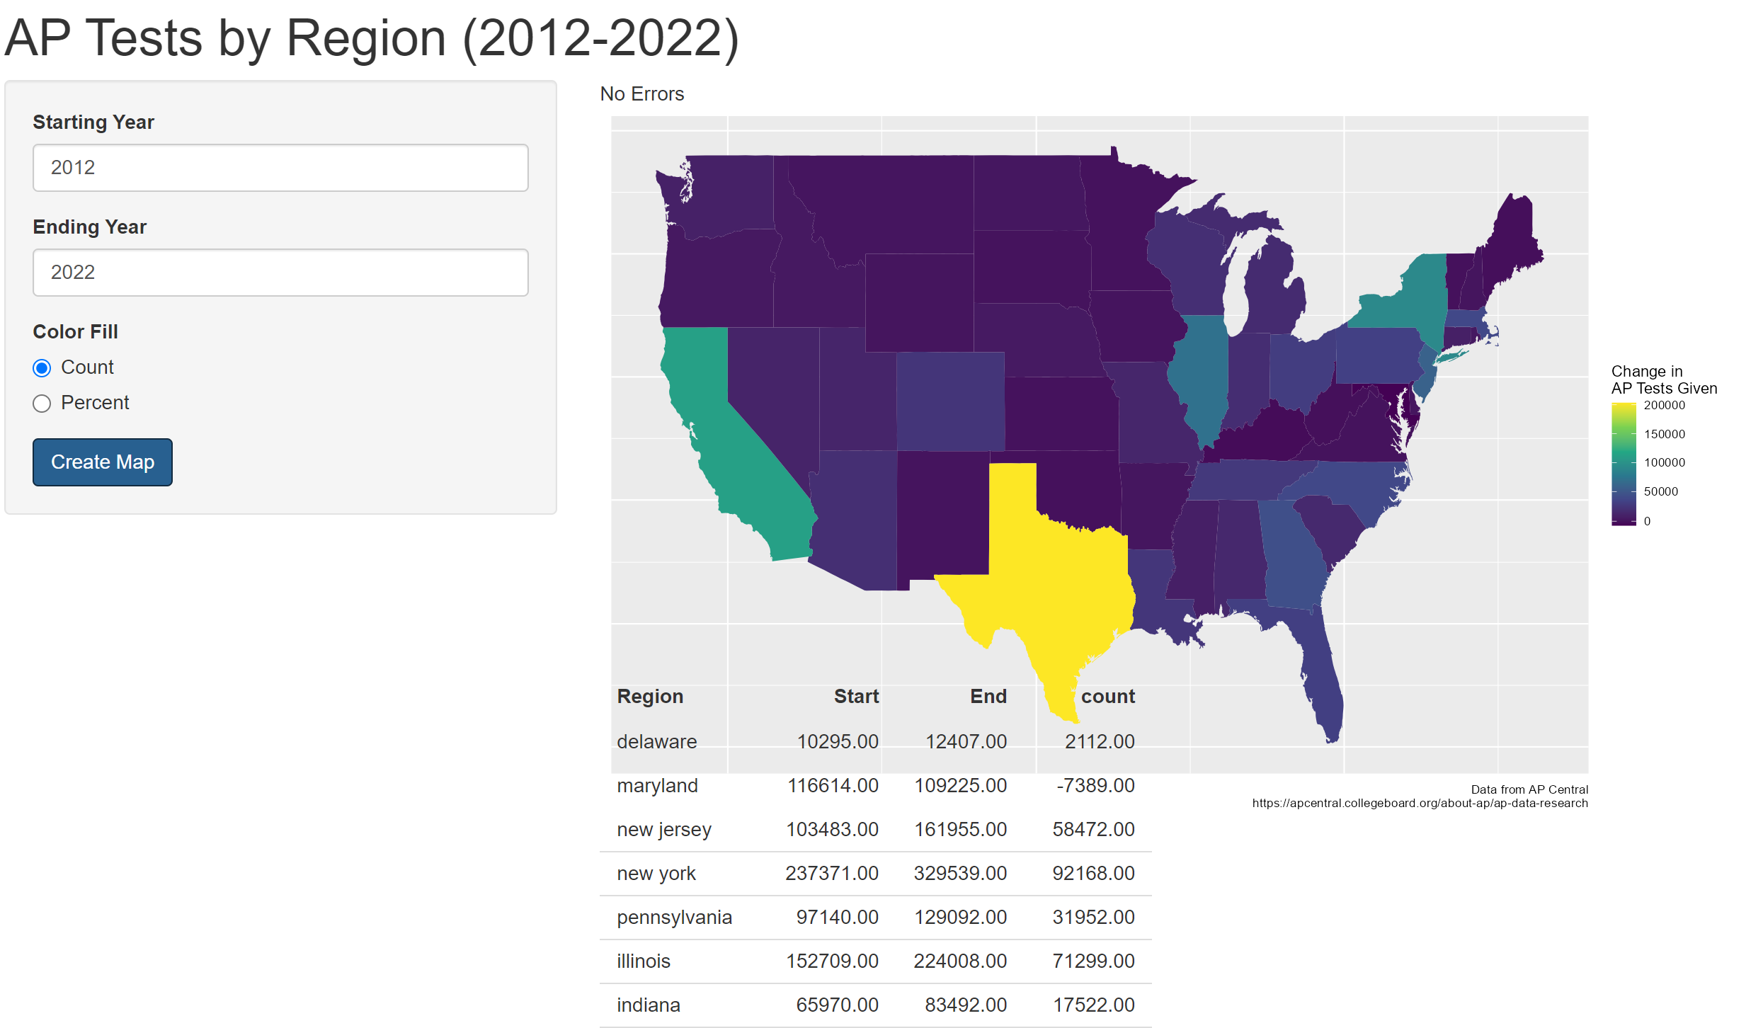
Your Choices
When you first open the app, it displays a visualization of the data that is a change in the number count of exams given by region from 2012 to 2022.
You then have the option to adjust the starting and ending year as well as if it is a number count change or a percent change between those years.
I’ve included a custom error message if the values are not between 2012 and 2022.
Underneath the map is a table of values if more specific investigation is required.

Slide 5
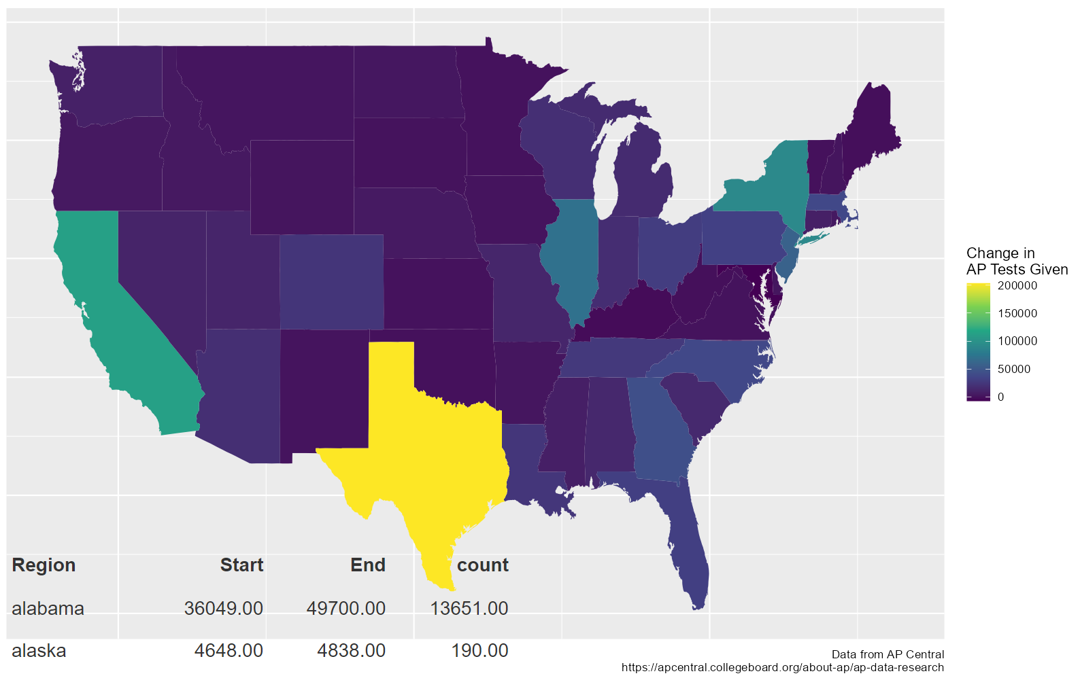
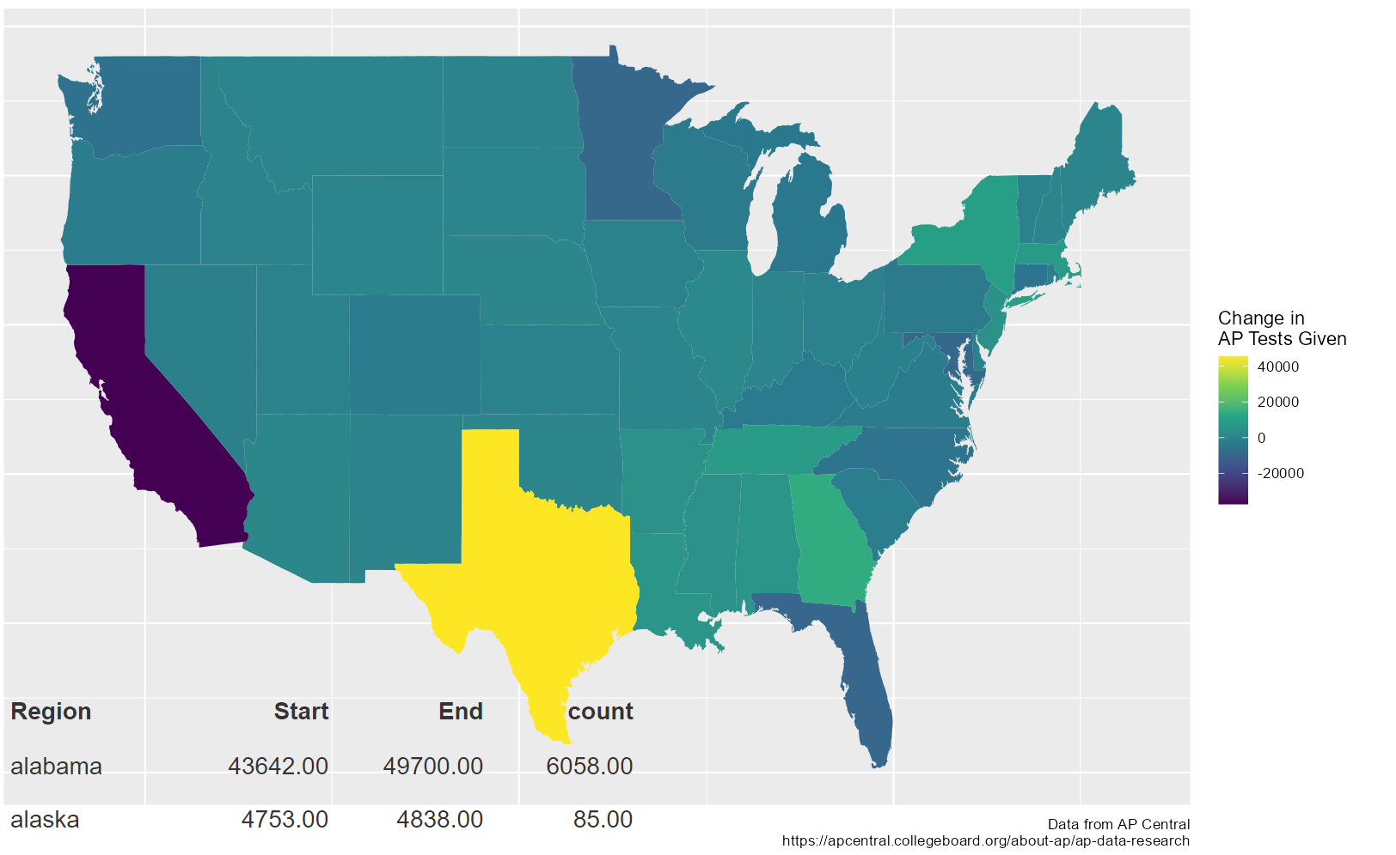
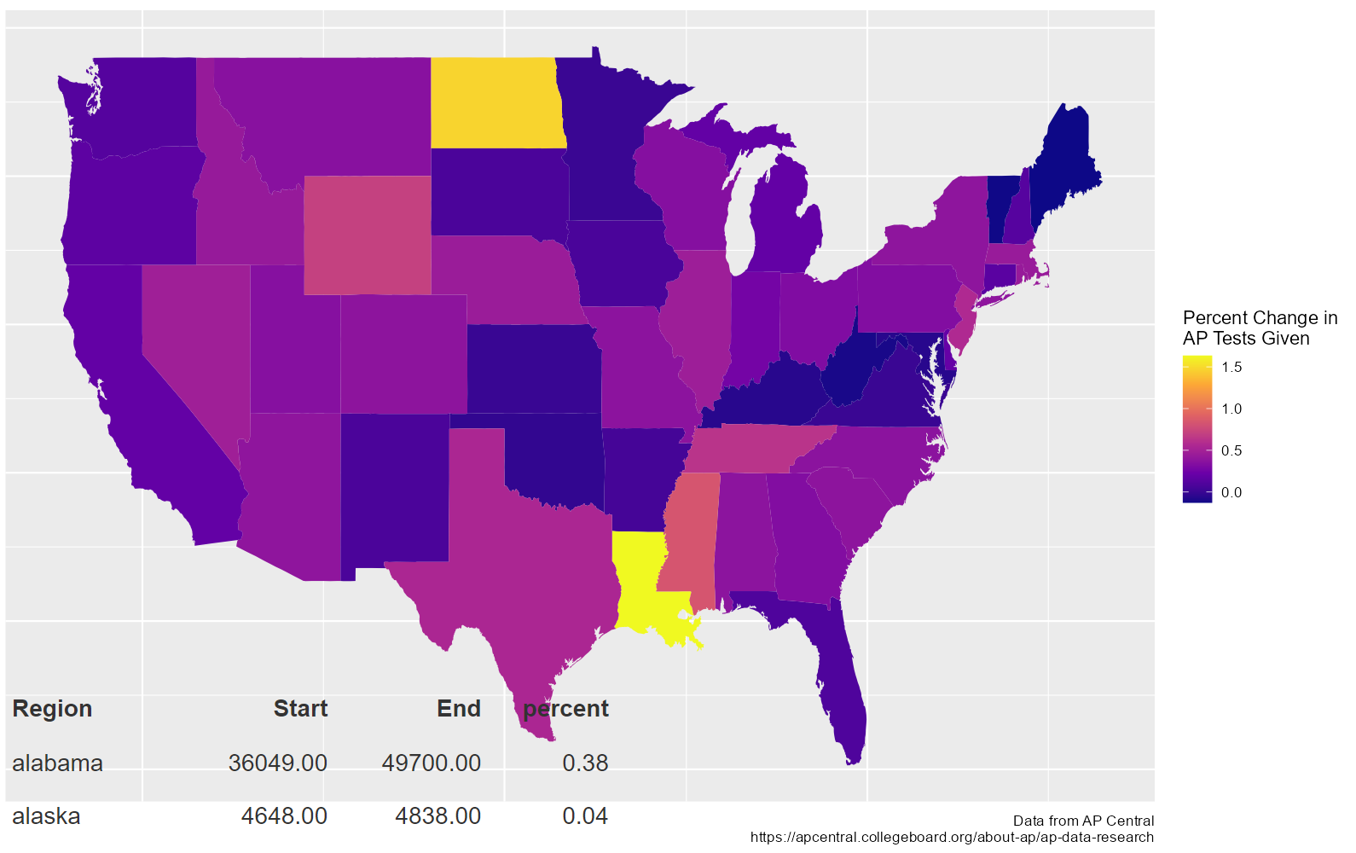
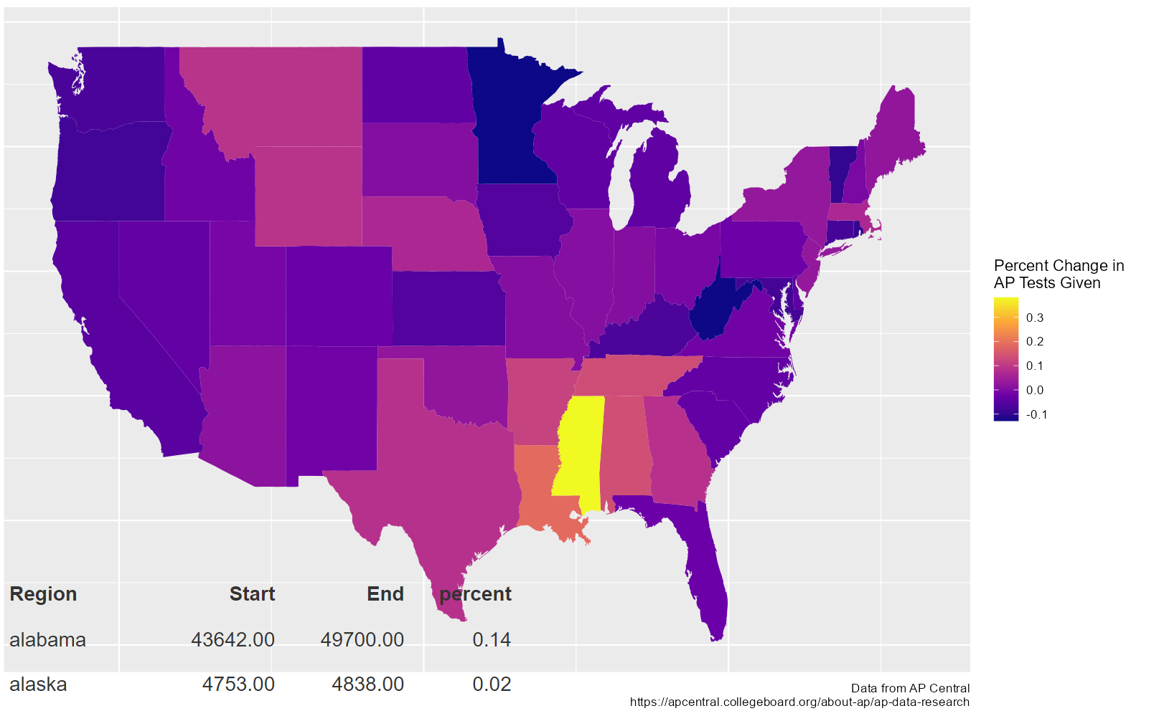
Let’s Explore Count vs Percent
←Large Counts:
Texas
California
New York
Illinois
→Large Counts:
Texas (+)
California (-)
←Large Percents:
Louisiana
North Dakota
Mississippi
→Large Percents:
Mississippi
Louisiana
2020 – 2022
2012 – 2022

Slide 6
The Analysis
Since the populations of states like Texas, California, and New York are among the highest, it makes sense that they’re going to see the largest count increase over those ten years. Likewise, since North Dakota has one of the lowest populations, it makes sense that they’re going to see a high percent increase over ten years. The most interesting, I think, is the percent growth in Louisiana and Mississippi. They stick out from the pattern and that shows that there is substantial growth for the AP program in those states.
Questions for follow-up:
What are Louisiana and Mississippi doing differently than other states?
Why did California (a higher populated state) lose so many AP exams from 2020 to 2022 when other states didn’t seem to be as affected?

Slide 7
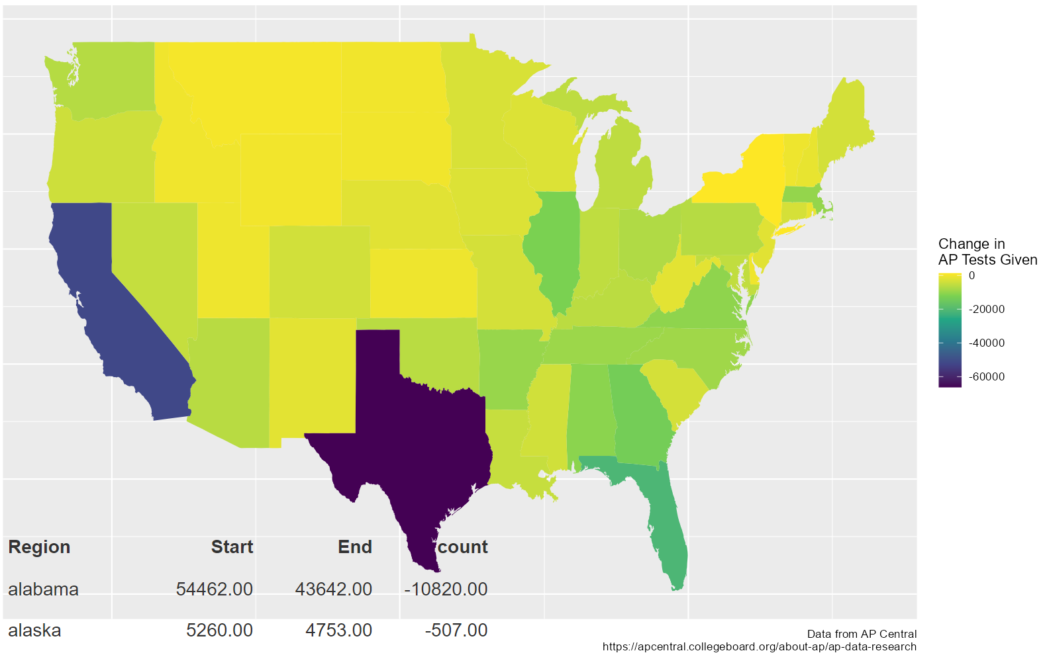
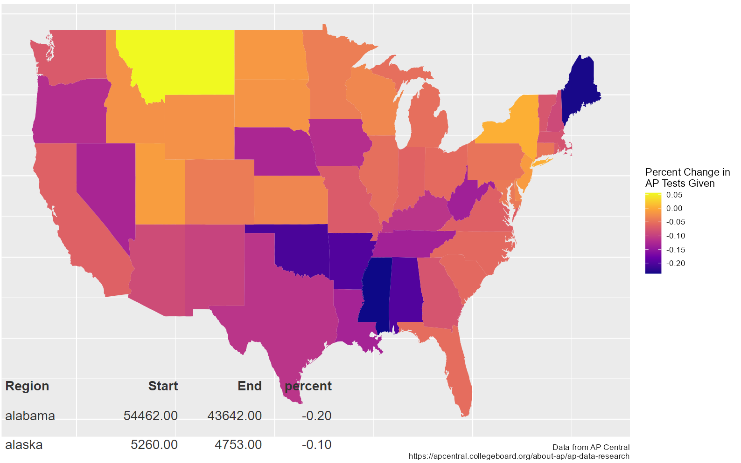
Let’s Explore Specific Years
2019 – 2020

Slide 8
The Analysis
Again, we see highly populated states like Texas, California, and Florida with the biggest counts. However, this time the counts are negative! I was curious to check these years because of the COVID pandemic. I wanted to see how AP exam numbers were affected. States like Montana, where the population is much more spread out, remarkably still saw growth during this year.
Questions for follow-up:
Why did the pandemic have a negative effect on AP exam numbers?
How did COVID regulatory measures differ between states?
Are the regions that saw the most COVID outbreaks correlated with the regions that had the biggest decline in AP exams (count or percent)?

Slide 9
Your Turn
You can find this application on GitHub
You can find this dataset as well as others at AP Data and Research – AP Central | College Board
You can email me at zgummersheimer@kumc.edu if you have any other questions about the app or the data.

